Slide 1


Machine Learning
With python
ESB1: ensemble MODELS
Boosting, Bagging, Voting
Notes:
Layout objects pulled from: https://slidesgo.com/
All icons are from: https://thenounproject.com/

Slide 2
Colab workbook
Link: click for access

Slide 3
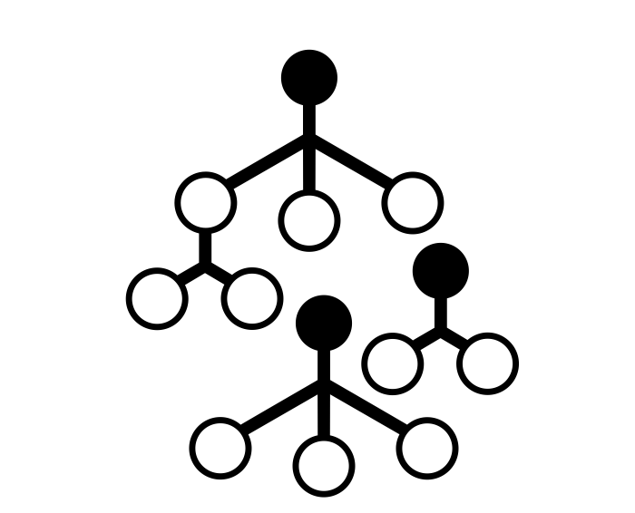

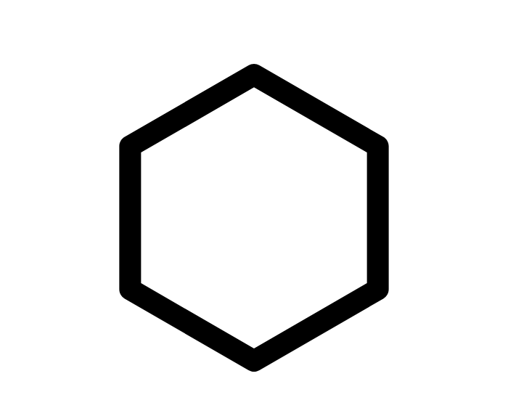
Ensemble models
combine the strengths of different models to improve accuracy, reduce mistakes, and create more reliable results (doc here)
bagging
base models
base models
voting
boosting
stacking
meta

Slide 4
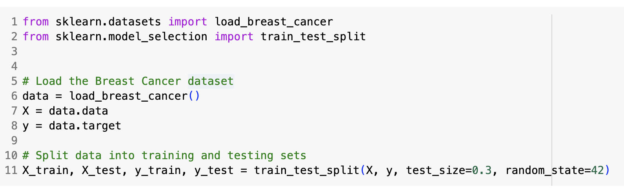
Breast cancer dataset
binary classification (malignant vs benign)
569 samples and 30 numeric features
no missing values
some correlated features
small enough to train models quickly, but complex enough to benefit from tuning

Slide 5
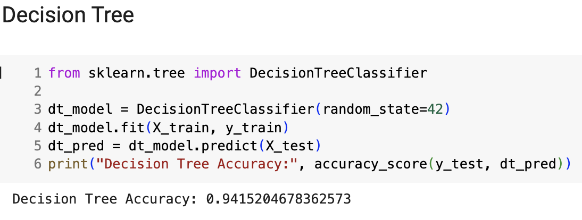
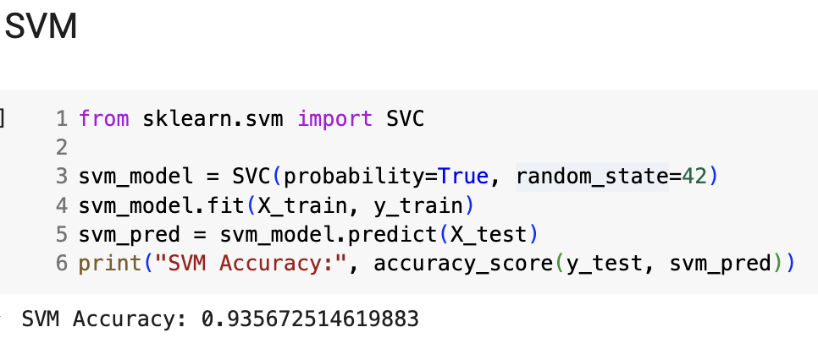
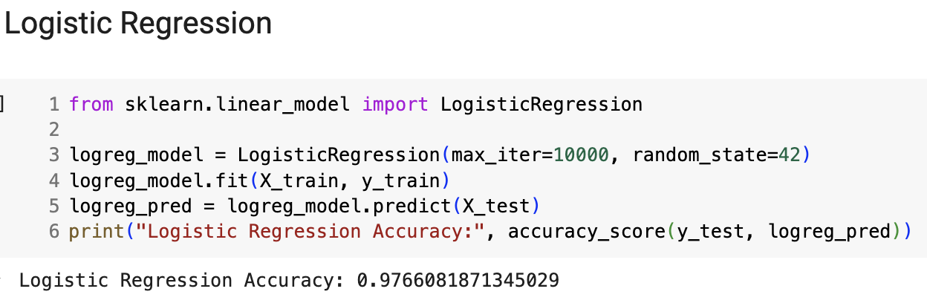
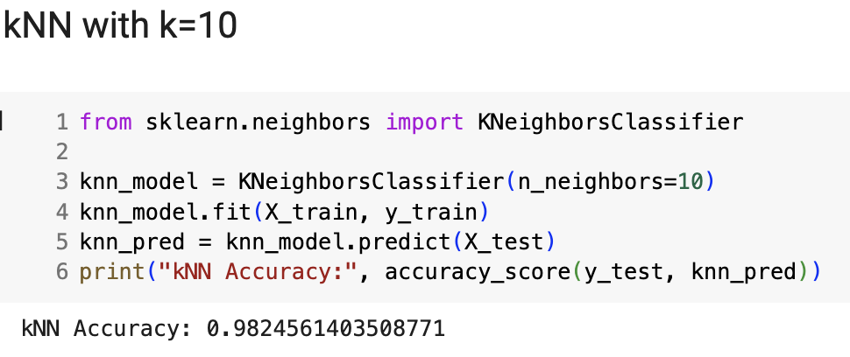
basic models
okay
let’s improve this
and this
ideal

Slide 6
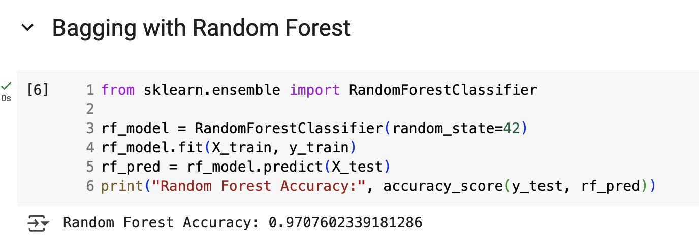
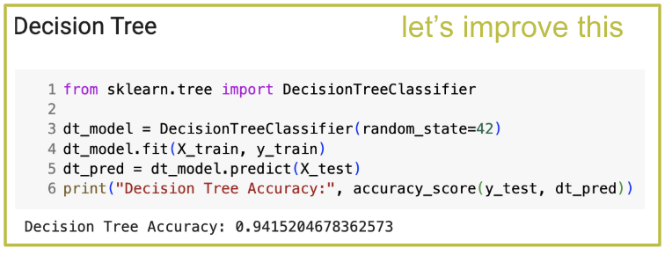
Bagging reduces variance and overfitting by creating multiple subsets of data through bootstrap sampling. Each model is trained independently on a different subset, and predictions are made by averaging (regression) or voting (classification) the outputs.
Best For | When Not to Use | Reduces | Model Training | Data Needed | Interpretability | Tuning Effort
High variance, overfitting | Low variance, limited dataset | Variance | Parallel | Moderate | Moderate | Low

Slide 7
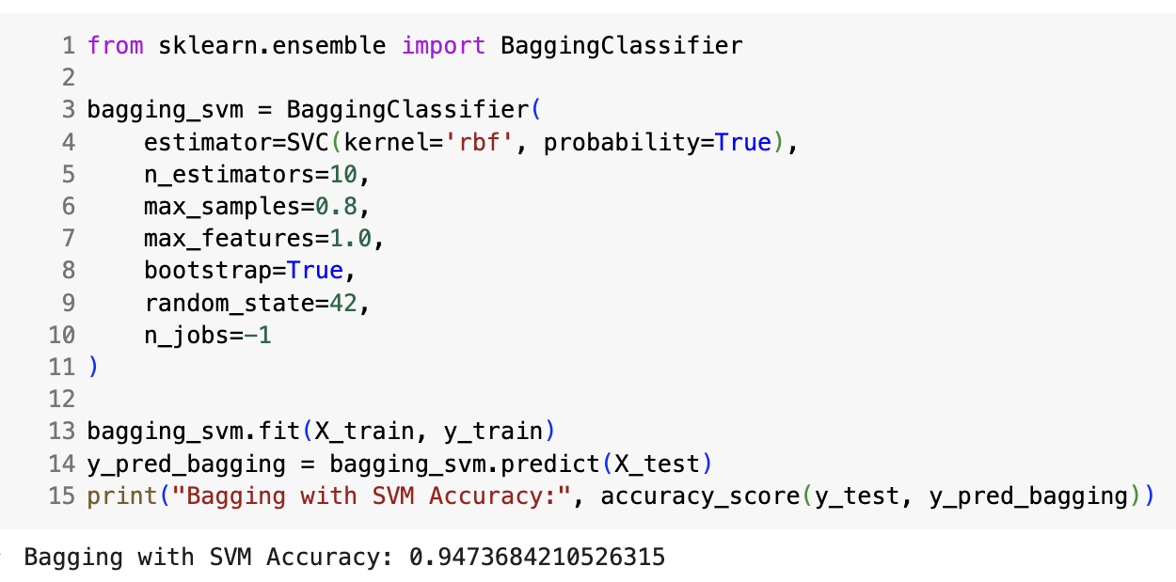
Bagging reduces variance and overfitting by creating multiple subsets of data through bootstrap sampling. Each model is trained independently on a different subset, and predictions are made by averaging (regression) or voting (classification) the outputs.
BaggingClassifier doc
let’s improve this
Best For | When Not to Use | Reduces | Model Training | Data Needed | Interpretability | Tuning Effort
High variance, overfitting | Low variance, limited dataset | Variance | Parallel | Moderate | Moderate | Low

Slide 8
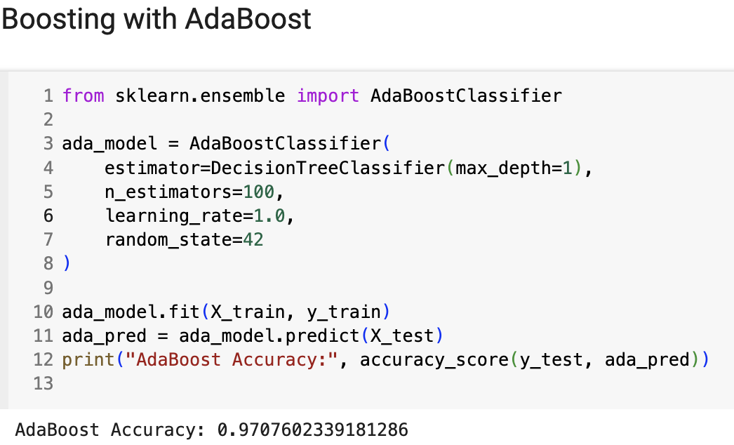
boosting builds models sequentially, with each new model attempting to correct the errors made by the previous one. It assigns higher weights to misclassified instances, forcing the model to focus on difficult cases. Each new tree is built on the residuals (errors) of the previous tree. The final model is a weighted sum of all the trees, with each tree addressing the mistakes of the prior one.
AdaBoostClassifier doc
Best For | When Not to Use | Reduces | Model Training | Data Needed | Interpretability | Tuning Effort
High bias, complex/noisy data, weak learners | Need fast training, model already complex | Bias + Variance | Sequential | Moderate–High | Low | High

Slide 9
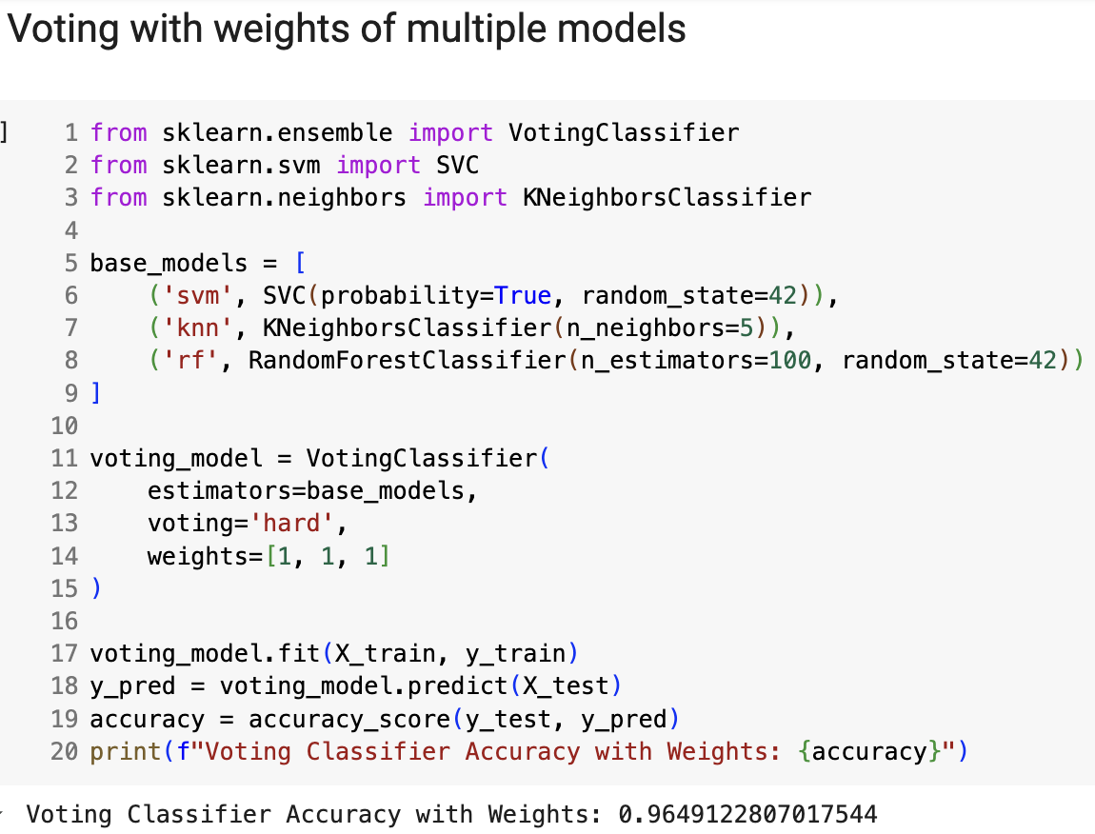
VotingClassifier doc
voting combines the predictions of several models to improve accuracy and stability by reducing the likelihood of errors caused by any single model. The voting can be hard (majority) or soft (probability-based)
Best For | When Not to Use | Reduces | Model Training | Data Needed | Interpretability | Tuning Effort
Simple ensemble of strong models | Base models too weak or too similar | Variance | Parallel | Low–Moderate | High | Low–Moderate

Slide 10
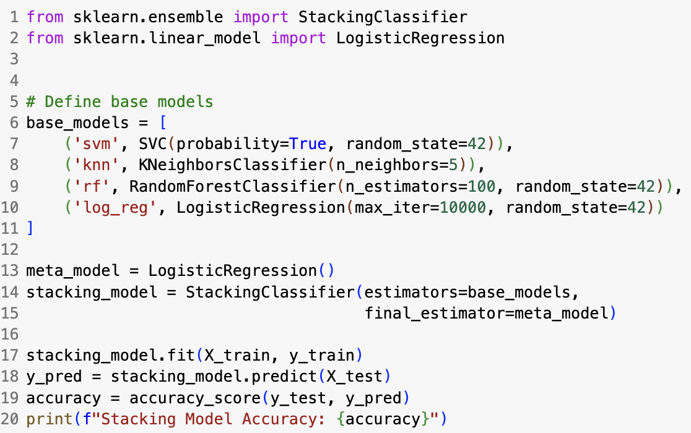
stacking combines the predictions of several models to use as input to a meta-model which makes the final prediction. Leverages the strengths of various base models to make more accurate predictions, combining models that may capture different aspects of the data
StackingClassifier doc
Best For | When Not to Use | Reduces | Model Training | Data Needed | Interpretability | Tuning Effort
Combining diverse models | Limited data, need interpretability | Bias + Variance | Layered (meta) | High | Low | High

Slide 11

Exercise
Which of the ensemble models that we’ve seen so far has done the best? Why do you think that is?
Is there anything else we should consider when picking the best model?

Slide 12
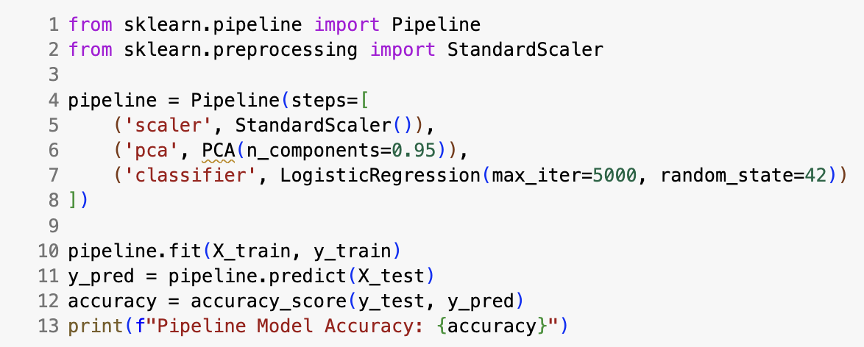
pre-processing steps here
pipeline information here

Slide 13
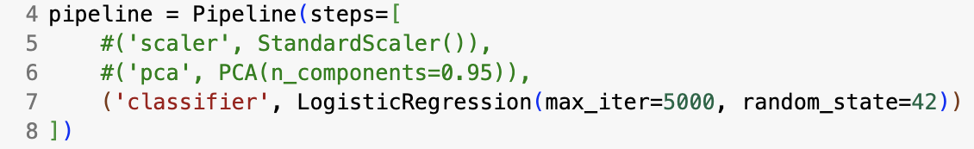

Exercise
What model is being used?
What's the accuracy of only having the model in the pipeline?
For each of the following combinations of steps in the pipeline, write down the accuracy of the pipeline. Did the accuracy improve? Explain.
Add scaling step into the pipeline
Add PCA step into the pipeline
Keep PCA step, remove scaler step

Slide 14
Machine Learning
With python
ESB2: ensemble MODELS
Hyperparameter Tuning Grids
Notes:
Layout objects pulled from: https://slidesgo.com/
All icons are from: https://thenounproject.com/

Slide 15
Colab workbook
Link: click for access

Slide 16
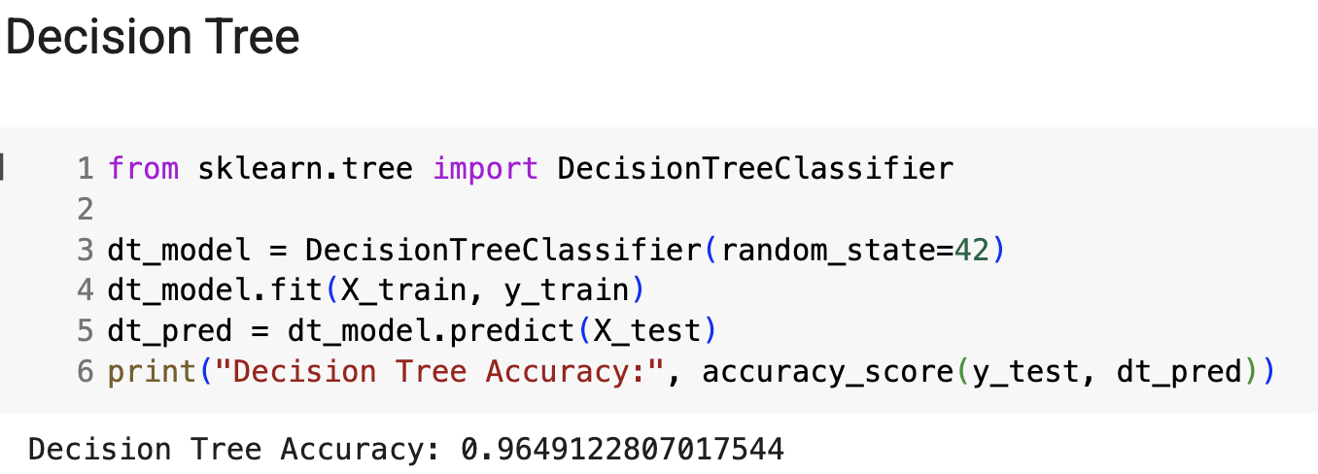
max_features: The number of features to consider when looking for the best split. Adds randomness to help generalize better. Try values: [None, 'sqrt', 'log2']
max_depth: Limits how deep the tree can grow. Prevents overfitting by capping complexity. Try values: [None, 5, 10, 15, 20]
min_samples_split: Minimum number of samples required to split an internal node. Higher values reduce overfitting. Try values: [2, 5, 10, 20]
criterion: The function used to measure the quality of a split. Gini is faster; entropy can be more precise. Try values: ['gini', 'entropy']
min_samples_leaf: Minimum number of samples required to be at a leaf node.Ensures leaves aren't too specific. Try values: [1, 2, 4, 10]

Slide 17
Exercise
The following are additional arguments you can pass into DecisionTreeClassifier to help tune and improve the model’s performance. Each parameter controls a different aspect of how the tree is built.
1. Pick one of the parameters and update the DT model to test different values from the list. Keep updating the value until you reach the best possible accuracy on your validation/test data.
2. Pick a second parameter and repeat the process — updating the DT model until you find the best setting.
3. Which parameter had the biggest impact on model accuracy? Why do you think that was the case?
max_depth: Limits how deep the tree can grow. Prevents overfitting by capping complexity. Try values: [None, 5, 10, 15, 20]
min_samples_split: Minimum number of samples required to split an internal node. Higher values reduce overfitting. Try values: [2, 5, 10, 20]
min_samples_leaf: Minimum number of samples required to be at a leaf node.Ensures leaves aren't too specific. Try values: [1, 2, 4, 10]
max_features: The number of features to consider when looking for the best split. Adds randomness to help generalize better. Try values: [None, 'sqrt', 'log2']
criterion: The function used to measure the quality of a split. Gini is faster; entropy can be more precise. Try values: ['gini', 'entropy']

Slide 18
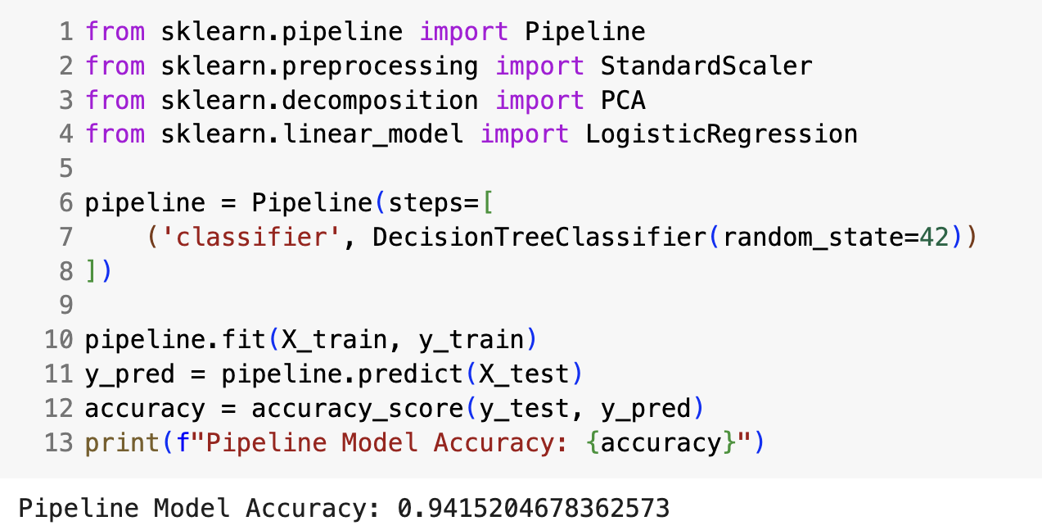
max_features: The number of features to consider when looking for the best split. Adds randomness to help generalize better. Try values: [None, 'sqrt', 'log2']
In order to make this more efficient, let’s take a look at how to use tuning grids to find the best parameters!
max_depth: Limits how deep the tree can grow. Prevents overfitting by capping complexity. Try values: [None, 5, 10, 15, 20]
add in some hyperparameter selections to this model.
min_samples_split: Minimum number of samples required to split an internal node. Higher values reduce overfitting. Try values: [2, 5, 10, 20]
criterion: The function used to measure the quality of a split. Gini is faster; entropy can be more precise. Try values: ['gini', 'entropy']
min_samples_leaf: Minimum number of samples required to be at a leaf node.Ensures leaves aren't too specific. Try values: [1, 2, 4, 10]

Slide 19
GridSearchCV performs an exhaustive search over a specified parameter grid. It evaluates every possible combination of hyperparameters in the defined search space to find the best performing set.
RandomizedSearchCV randomly samples hyperparameters from a predefined search space for a set number of iterations. It doesn't try every possible combination but rather samples a random subset.
Method
Exhaustive Search: Tests all possible combinations, ensuring that the best set of hyperparameters is found (if the search space is well defined).
Simple to Understand and Implement: Straightforward, with no randomness involved.
Faster Than GridSearchCV: Since it samples a random subset of the search space, it is usually much faster, especially for large parameter grids.
Can Explore a Larger Search Space: By sampling randomly, it can cover a wider range of possible hyperparameter combinations with fewer computations.
pros
Computationally Expensive: The number of combinations grows exponentially as the number of hyperparameters and their possible values increase, leading to long search times.
Inefficient with Large Search Spaces: If the grid of hyperparameters is very large, GridSearchCV can be very slow and resource-intensive, even when you only need a rough estimate of optimal values.
May Miss the Optimal Hyperparameters: Since the search is random, it might not find the exact best combination, especially if the number of iterations is low.
Less Deterministic: The results can vary from run to run depending on the random seed, leading to less consistency in the results compared to GridSearchCV.
cons

Slide 20
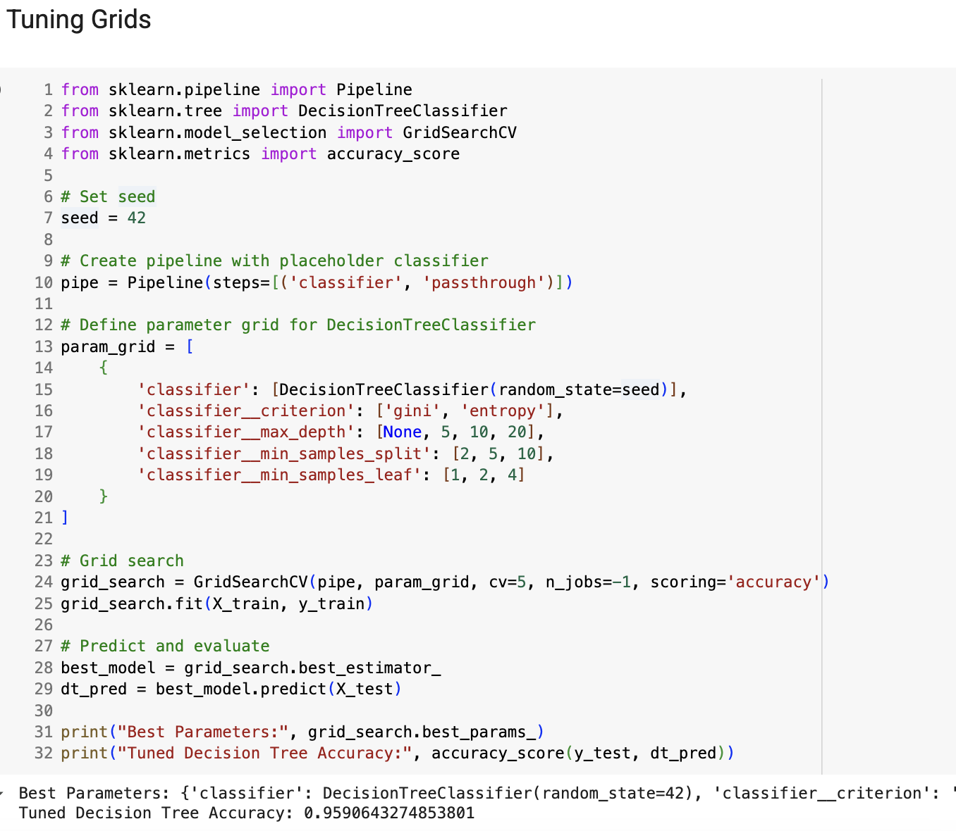

Slide 21
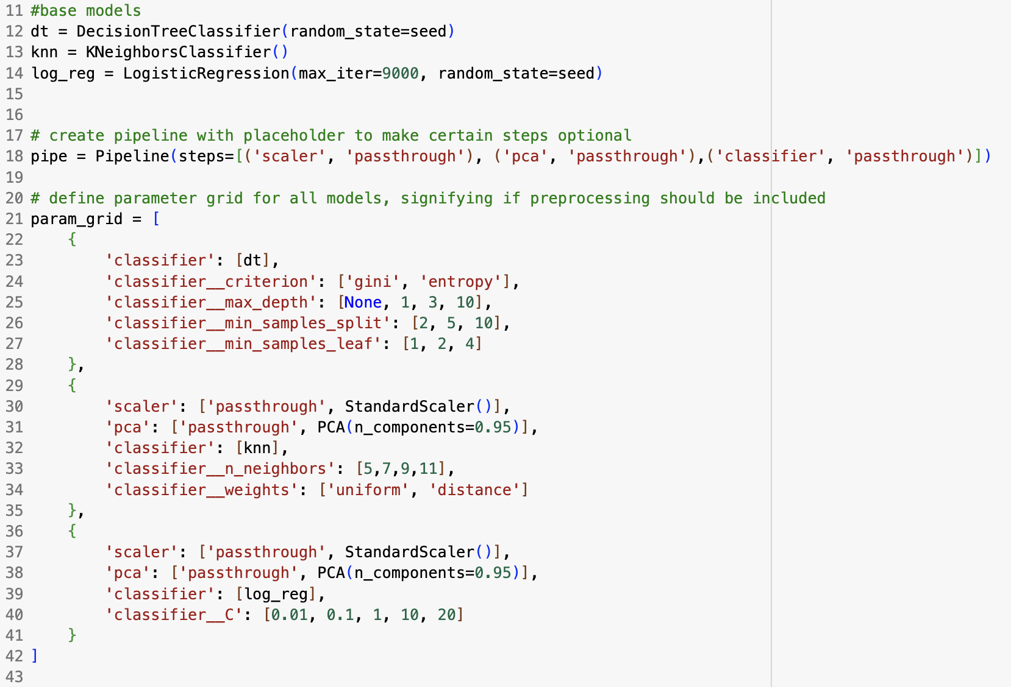
using the keyword passthrough essentially makes certain steps optional, and allows us the ability to create a more versatile param_grid

Slide 22

Exercise
Using the output of the best fit model above, discuss each of the hyperparameters as well as the model. Why do you think this model outperformed others?
Now, consider that an ideal model exists, and it's a different base model than the best fit model seen above. Our goal is to find that ideal model. We can do two things to find it: choose a different model, or pick better hyperparameter choices for the models we already have.
Choose at least two options below. After each option, rerun the pipeline. Did the best fit model change? Explain why this may be happening.
Refine the existing hyperparameter choices
Add a new model and include hyperparameters choices
Update grid search or cross validation

Slide 23

Work Time
HW7
View on our website

Slide 24
lab work time
Lab ESB Part 1 + 2
View on our website

Slide 25
Machine Learning
With python
ESB3: ensemble MODELS
model selection flowchart
Notes:
Layout objects pulled from: https://slidesgo.com/
All icons are from: https://thenounproject.com/

Slide 26
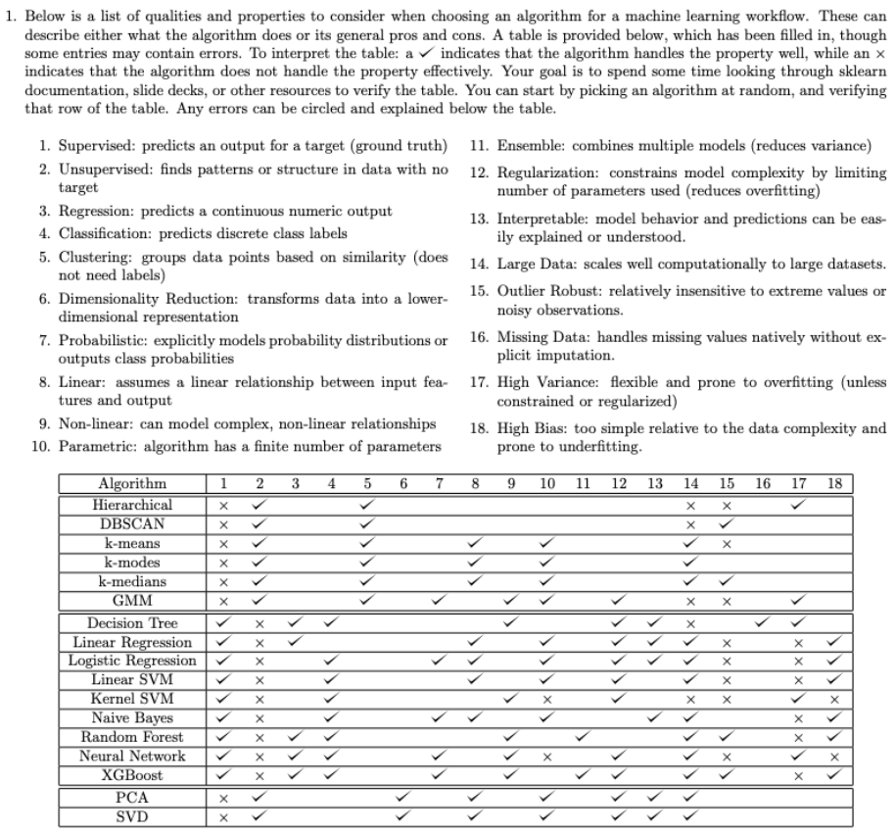

Slide 27
Unsupervised: Clustering
Unsupervised: Dimensionality Reduction
Hierarchical
DBSCAN
k-means
k-modes
k-medians
GMMs
PCA
SVM
(LDA)
Need to reduce dimensionality?
Has a target variable?
Supervised: Classification
Supervised: Regression
Decision Tree
Linear Reg
RF
NN
XGBoost
Decision Tree
Log Reg
Linear SVM
Kernel SVM
RF
NN
NB
XGBoost
Predicting a numeric value?

Slide 28
Unsupervised: Clustering
k-means
k-modes
N
Y
Prefer probabilities?
Categorical variables?
N
Hierarchical
Y
Y
Y
GMMs
Specify k?
Hierarchical?
N
Need to reduce dimensionality?
Y
Unsupervised: Dimensionality Reduction
N
N
DBSCAN
N
Has a target variable?
Y
Supervised: Classification
N
Y
Supervised: Regression
Predicting a numeric value?

Slide 29
Model Selection Flowchart
Unsupervised: Dimensionality Reduction
Topic Modeling?
Y
Probabilistic
Y
LDA
N
N
Unsupervised: Clustering
Need to reduce dimensionality?
Y
PCA
SVD
N
N
Has a target variable?
Y
Supervised: Classification
N
Y
Predicting a numeric value?
Supervised: Regression

Slide 30
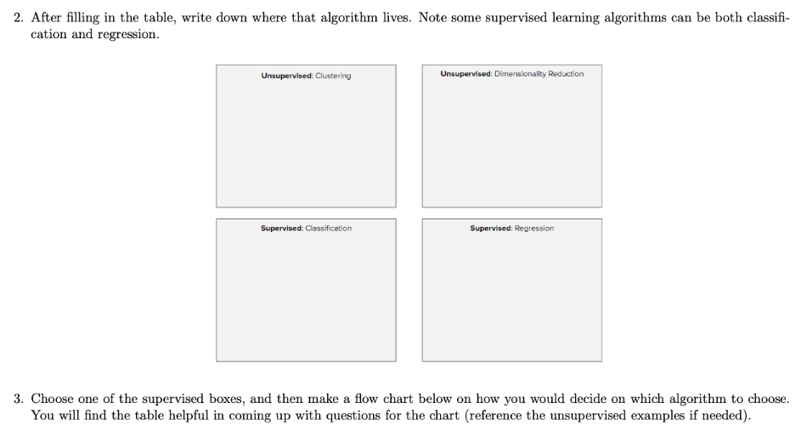

Slide 31
Model Selection Flowchart
Unsupervised: Clustering
Need to reduce dimensionality?
Y
Unsupervised: Dimensionality Reduction
N
N
Has a target variable?
Y
Supervised: Classification
N
Y
Supervised: Regression
Predicting a numeric value?
speed
interpretable / explainable
Speed or Accuracy
Linear Reg
Decision Tree
accurate
RF
NNs
XGBoost

Slide 32
Model Selection Flowchart
Unsupervised: Clustering
Need to reduce dimensionality?
Y
Unsupervised: Dimensionality Reduction
N
N
Has a target variable?
Y
Supervised: Classification
N
Supervised: Regression
Predicting a numeric value?
Y
Data is Too Large
N
Explainable
speed
Speed or Accuracy
N
Linear SVM
Y
Y
accurate
Naive Bayes
Linear Reg
Kernel SVM
NNs
Decision Tree
RF
XGBoost

Slide 33
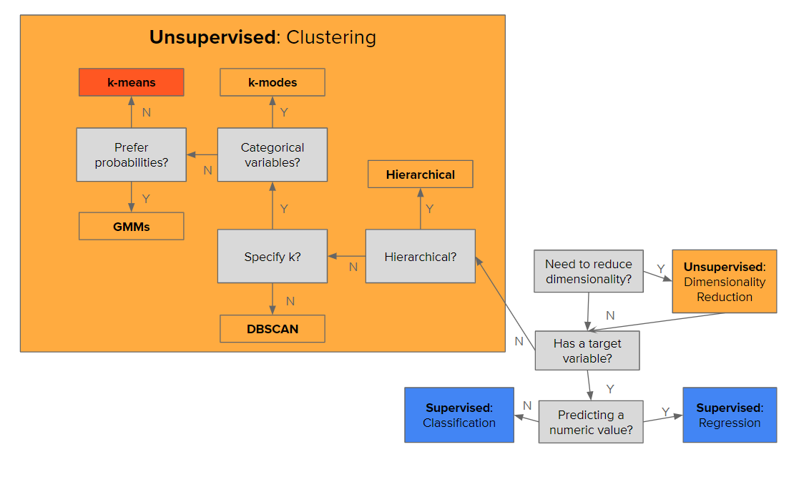
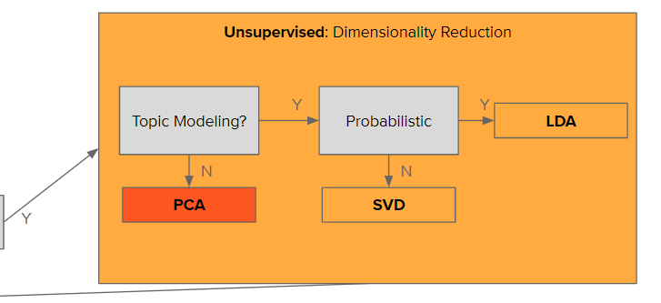
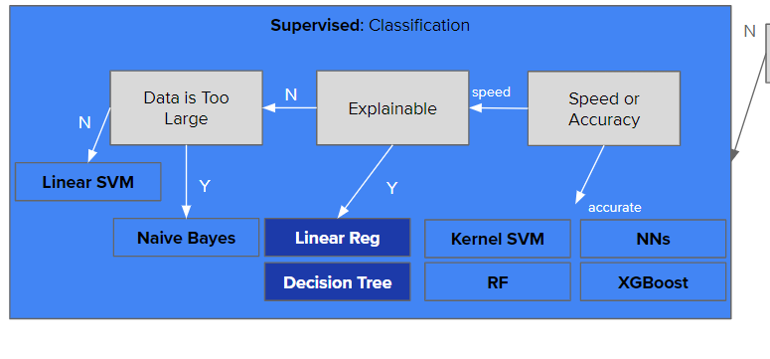
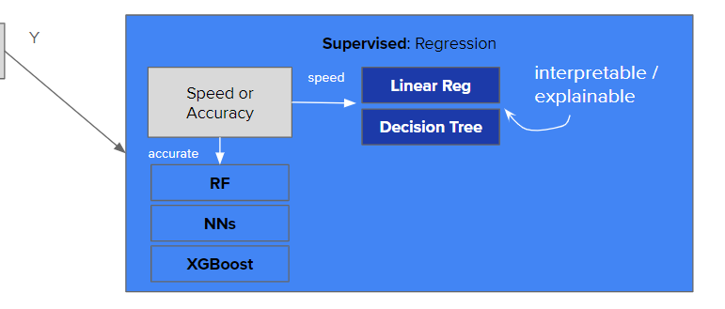

Slide 34


Slide 35
example
tuning workflow
Link: click for access

